Slide 1






Lead Scoring Case Study
TEAM :
Himanshu (himuchaudhari@gmail.com)
Himank (himank.Khandelwal@gmail.com)
Hemang (hhra2323@gmail.com)

Slide 2
Agenda
Introduction
Business Objective
Problem Statement
Lead – Conversion Process
Proposed solution
Solutions
Implementation
EDA
Logistic Regression Final Model
Conclusion
Recommendation

Slide 3
Business Objective
X Education, an education company, sells online courses to industry professionals.
Many interested professionals visit their website.
X Education wants to identify the most promising leads.
To achieve this, they aim to build a model that identifies hot leads and deploy this model for future use

Slide 4
Problem Statement
X Education receives many leads, but its lead conversion rate is very poor.
To improve this process, the company aims to identify the most promising leads, also known as
‘Hot Leads’.
By successfully identifying these leads, the lead conversion rate should increase as the sales team will focus on communicating with potential leads rather than calling everyone.
We will assist them in selecting the most promising leads, i.e., those most likely to convert into paying customers.
We need to build a model that assigns a lead score to each lead, indicating the likelihood of conversion, with higher scores representing a higher conversion chance.
The CEO has set a target lead conversion rate of 80%

Slide 5
Lead – Conversion Process
Lead Generation:
Ads on websites like Google
Referrals
Visitors either provide Email id & Contact Details
Or
View videos etc
Visit to X Education website by these potential customers (professionals)
Tele calling and Emailing activity to all the leads
~37% leads get converted
Proposed Solution: A model to filter leads so that leads to conversion ratio is 80%+

Slide 6
Proposed Solution
Selection of Hot Leads
We cluster the leads into categories based on their likelihood of conversion, resulting in a smaller group of
hot leads to focus on.
Communicating with Hot Leads
With a smaller set of leads to communicate with, we can achieve a greater impact through effective
communication.
Conversion of Hot Leads
By focusing on leads that are more likely to convert, we can improve our conversion rate and achieve the 80% target.

Slide 7
Solution
Selection of Hot Leads
For our solution, the crucial part is accurately identifying hot leads. The more accurately we identify hot leads, the higher our conversion ratio will be. Given our target of an 80% conversion rate, achieving high accuracy in identifying hot leads is essential.

Slide 8




Implementation
Univariate, Bivariate, and Heatmap for numerical and categorical columns
Performing pre- requisites for RFE and Logistic Regression
Loading & Observing data provided by the X- Education
Data Gathering
RFE and Logistic Regression
Data
Cleaning
Performing
EDA
Outlier
Treatment
Missing Value and
Outlier Treatment, Feature-Standardization
Correct Data Type

Slide 9
Implementation
Verifying our Final Model Accuracy etc. with model built with PCA
Selection of top 15
features using RFE
Reduction of columns and Model re-building
Model Building
Feature
Selection
Model Improvement
Model
Analysis
Model
Verification
Model building using RFE for
selected columns
Final Model Analysis and
performance on Test Data

Slide 10
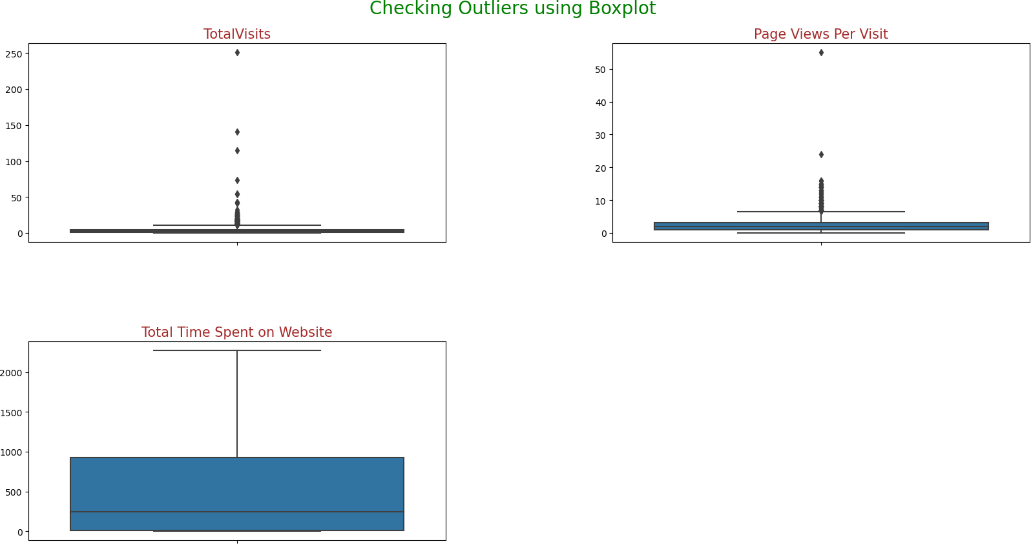
EDA - Box Plot - Outliers

Slide 11
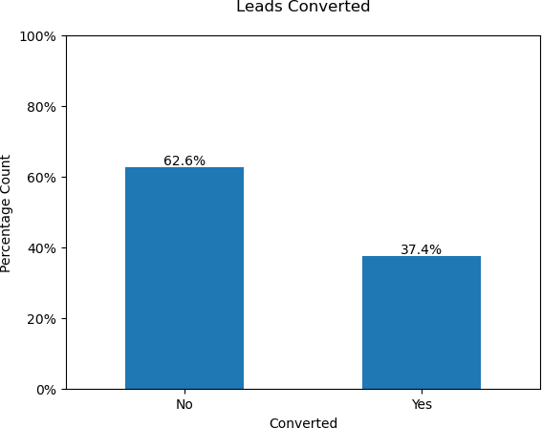
EDA - Univariate Analysis

Slide 12
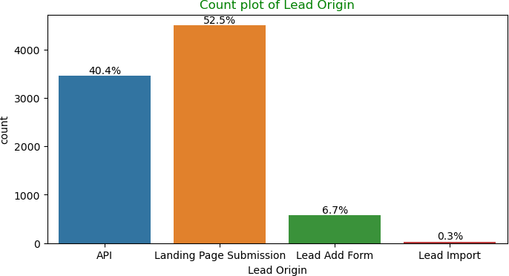
EDA - Univariate Analysis

Slide 13
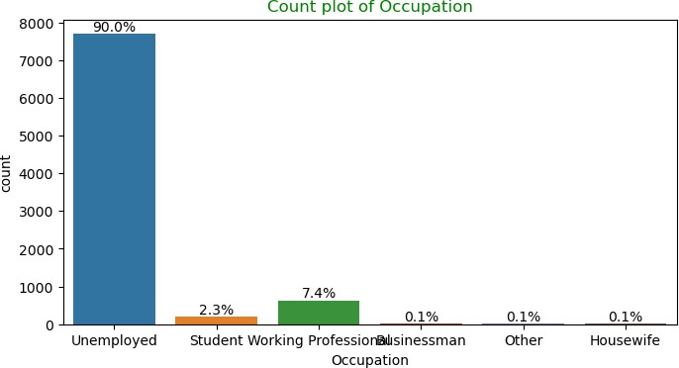
EDA - Univariate Analysis

Slide 14
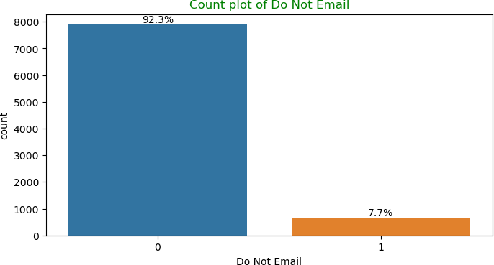
EDA - Univariate Analysis

Slide 15
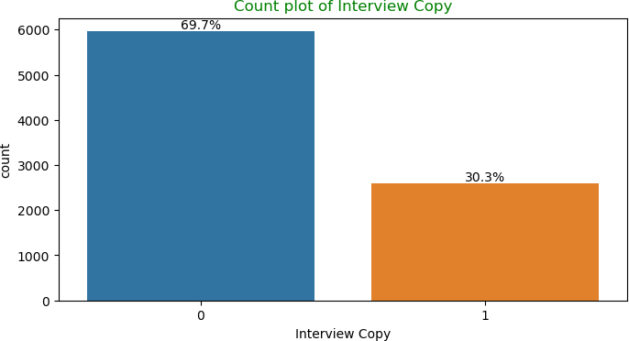
EDA - Univariate Analysis

Slide 16
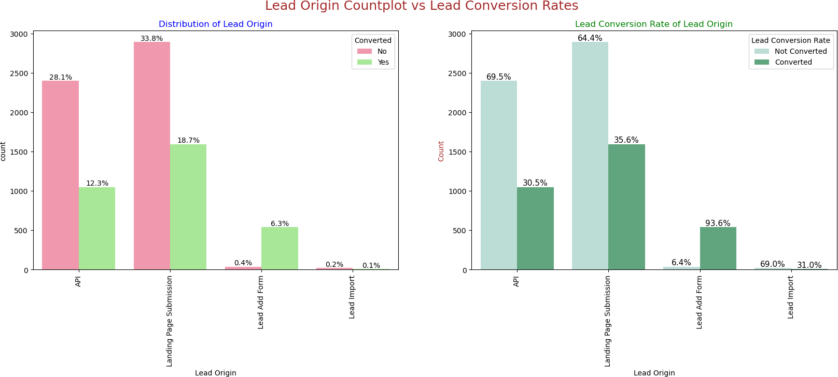
EDA - Bivariate Analysis

Slide 17
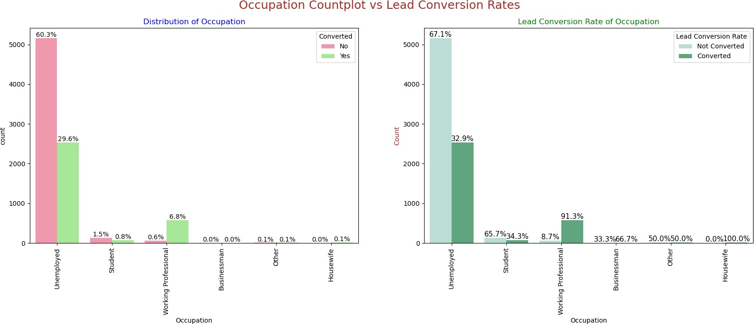
EDA - Bivariate Analysis

Slide 18
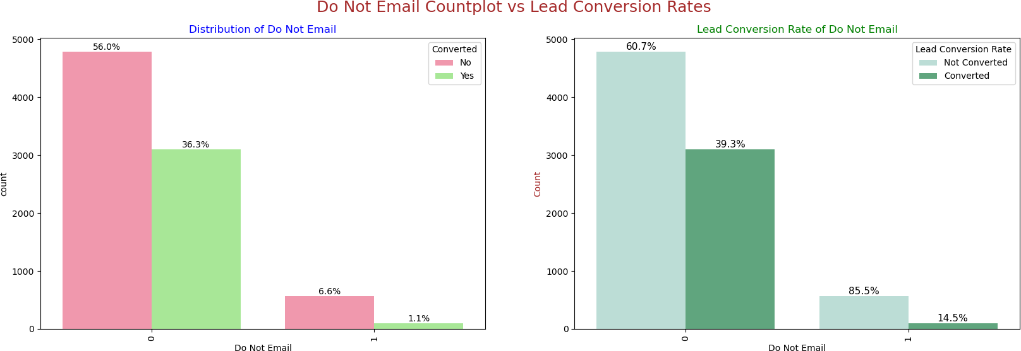
EDA - Bivariate Analysis

Slide 19
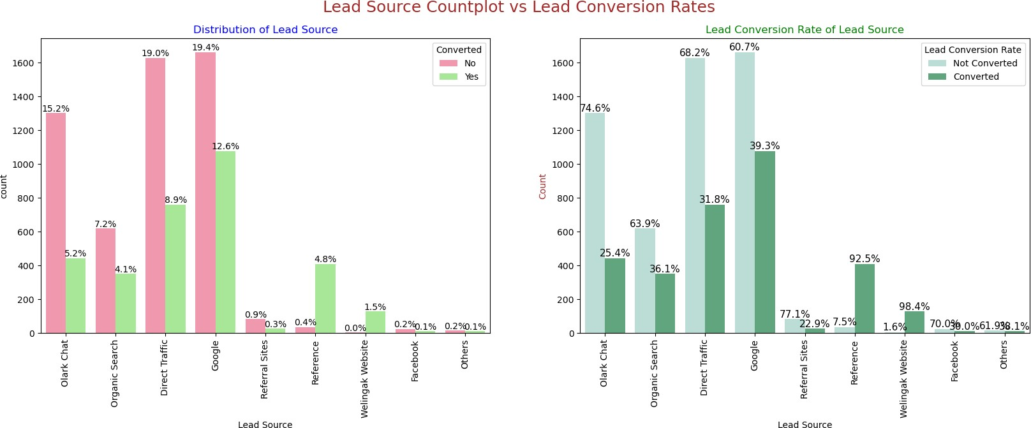
EDA - Bivariate Analysis

Slide 20
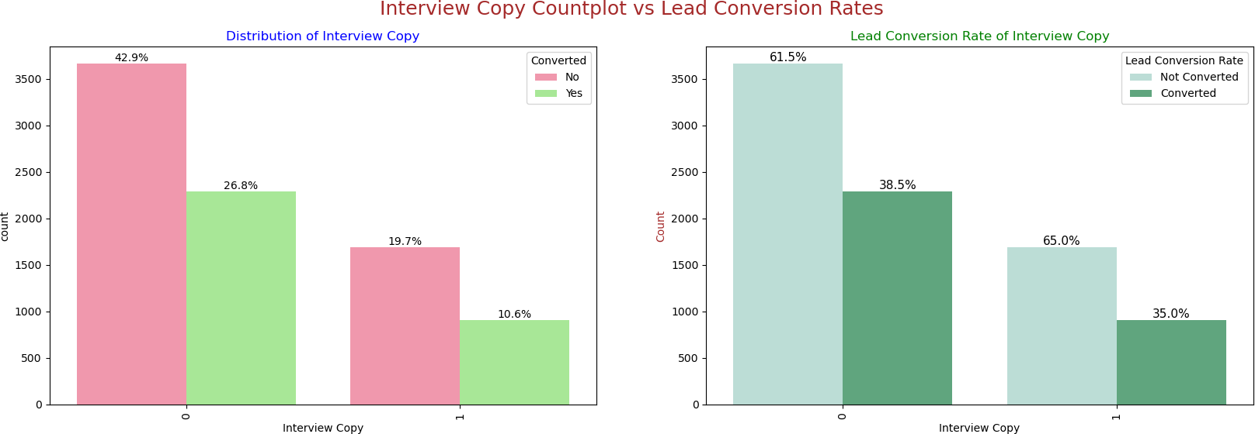
EDA - Bivariate Analysis

Slide 21
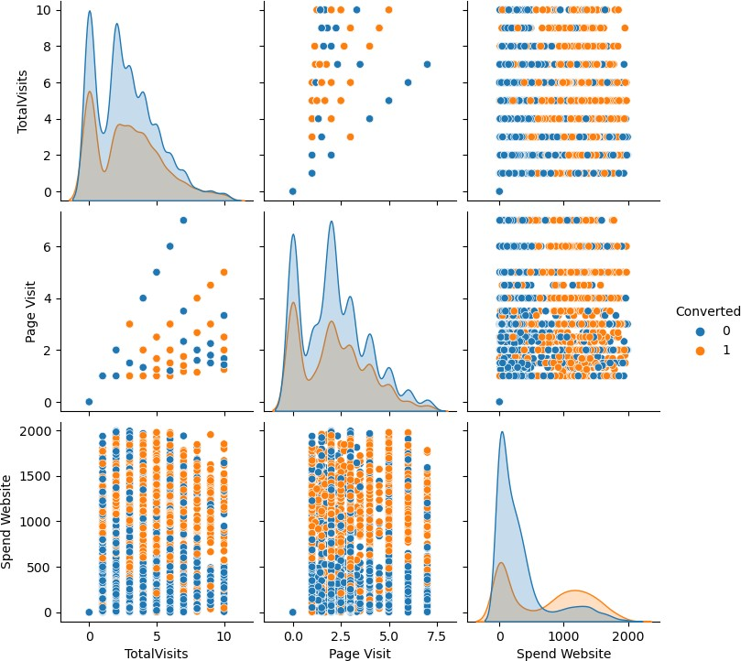
EDA - Bivariate Analysis

Slide 22
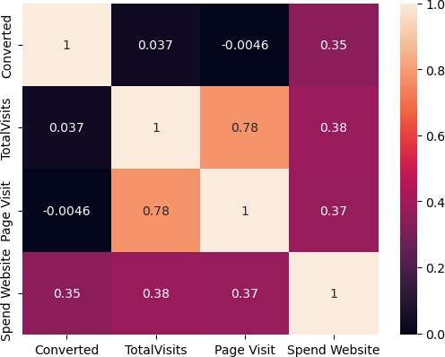
EDA - Heatmap (All Numerical Columns)

Slide 23
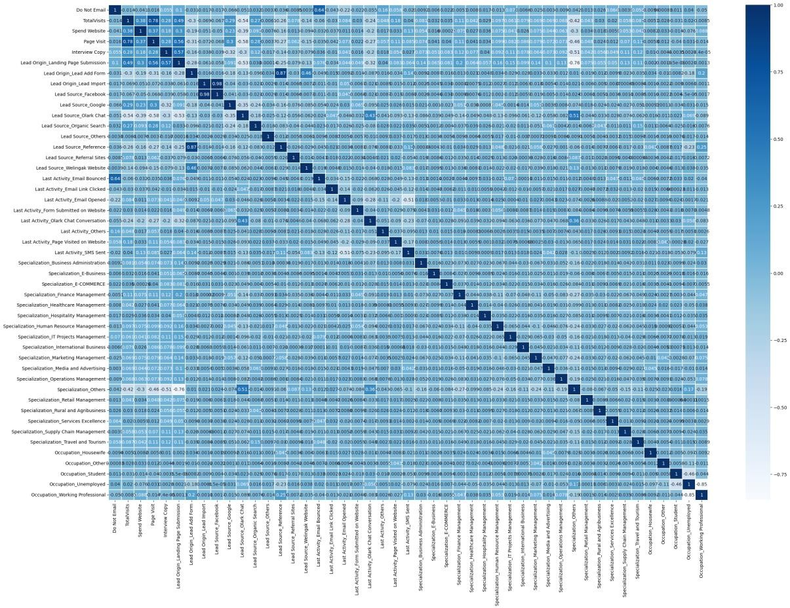
EDA - Heatmap (Numerical & Dummy Columns)

Slide 24
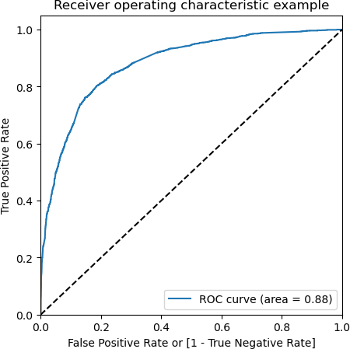
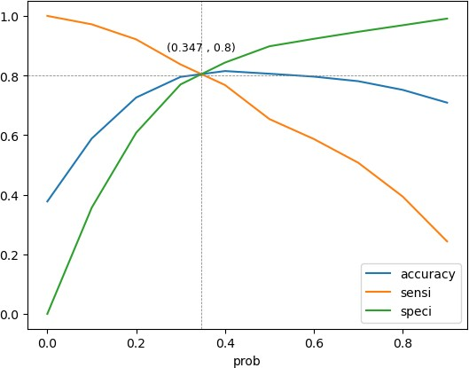
Linear Regression Final Model

Slide 25
Conclusion
Performance on Test Data
Accuracy : 80.63%
Sensitivity : 79.38%
Specificity : 81.35%

Slide 26
Conclusion
The top three variables in the final model that most significantly contribute to the probability of a lead converting are
Lead Source_Welingak Website: 5.48
Lead Source_Reference: 3.23
Last Activity_SMS Sent: 2.80

Slide 27
Recommendation
Focus on High-Potential Leads: Leads from the following sources have a higher likelihood of conversion based on the coefficients: o Welingak Website:
5.48 o Reference: 3.23 o Working Professional: 2.64 Therefore, the sales team should prioritize calling leads from these sources during the intern-hiring period.
Leverage Effective Communication Channels: Leads who have been sent SMS messages and have opened emails are more likely to convert. The coefficients for Last_Activity_Others and Last Activity_Email Opened are 1.91 and 1.65, respectively. Thus, the sales team should prioritize calling leads who have been sent SMS messages or have opened emails from X Education.
Maximize Website Engagement: Total Time Spent on the Website and Lead Source_Facebook are the good indicator of a lead's interest in X Education's services, with a coefficient of 1.047 and 1.14. Hence, the sales team should also prioritize calling leads who have spent significant time on the website.
Maintain a Multi-Channel Approach: Finally, the sales team should follow up with leads who have interacted with X Education through multiple channels. For example, leads who have used the Olark Chat feature on the website may not have spent much time on the website but may still be interested in X Education's services. Therefore, the sales team should ensure they follow up with leads who have used multiple channels to interact with X Education.

Slide 28
Thank you

